Slide 1
YANG model and implementation of Network Interconnect Tester
IETF113 Hackathon
March 19-20, 2022
Online
Notes:
<number>

Slide 2
The project
Specification:
* draft-vassilev-bmwg-network-interconnect-tester-07
Client side:
* Example script – rfc2544.py benchmark (Python)
Device side:
* Software - ​YANG/NETCONF server instrumentation code (C)
* Firmware - ​(Verilog)
* Hardware – off-the-shelf FPGA module​ Ultra96 + 6x SFP+ network programmability kit shield (KiCAD, Walk-through)
1

Slide 3
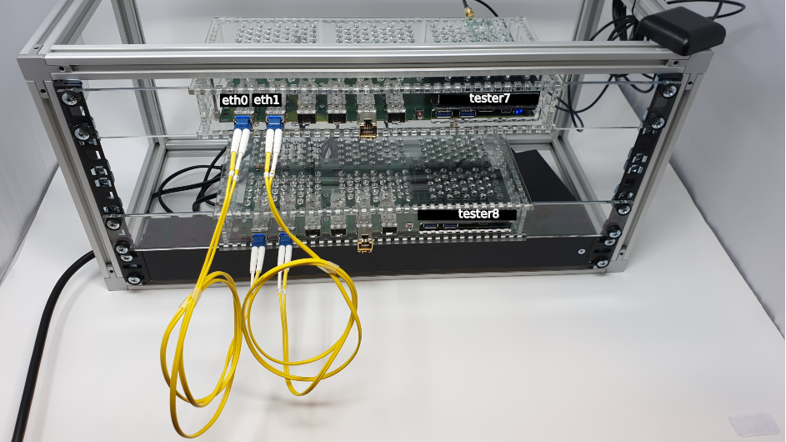
Setup
+-----------------+
eth0 | | eth1
+-<|TG tester7 TA|<-+
| | | |
| +-----------------+ |
| |
| +-----------------+ |
| | | |
+->|TA tester8 TG|>-+
| |
+-----------------+
+-----------------+
eth0 | | eth1
+-<|TG tester0 TA|<-+
| | | |
| +-----------------+ |
| |
+-----------------------+
1

Slide 4
Design and implementation
NETCONF Server (Model (YANG), Implementation Generator module (C), Analyzer module (C))
TRAFFIC-GENERATOR-SW (C) TRAFFIC-ANALYZER-SW (C)
| |
Socket API Socket API
| \ | / |
Kernel Sync ->{RTCLOCK}(Verilog) Kernel
| PPS / | \ |
DMA DMA
| [AXI] | [AXI]
MAC TRAFFIC-GENERATOR-HW (C,Verilog) MAC TRAFFIC-ANALYZER-HW (C,Verilog)
\ / | |
\ / | |
GMII_MUX +---+---+
| [GMII] | [GMII]
PHY PHY
| |
SFP+ TX SFP+ RX
| |
+->----------------------------------->-+
* - underlined text has links to repositories
<number>

Slide 5
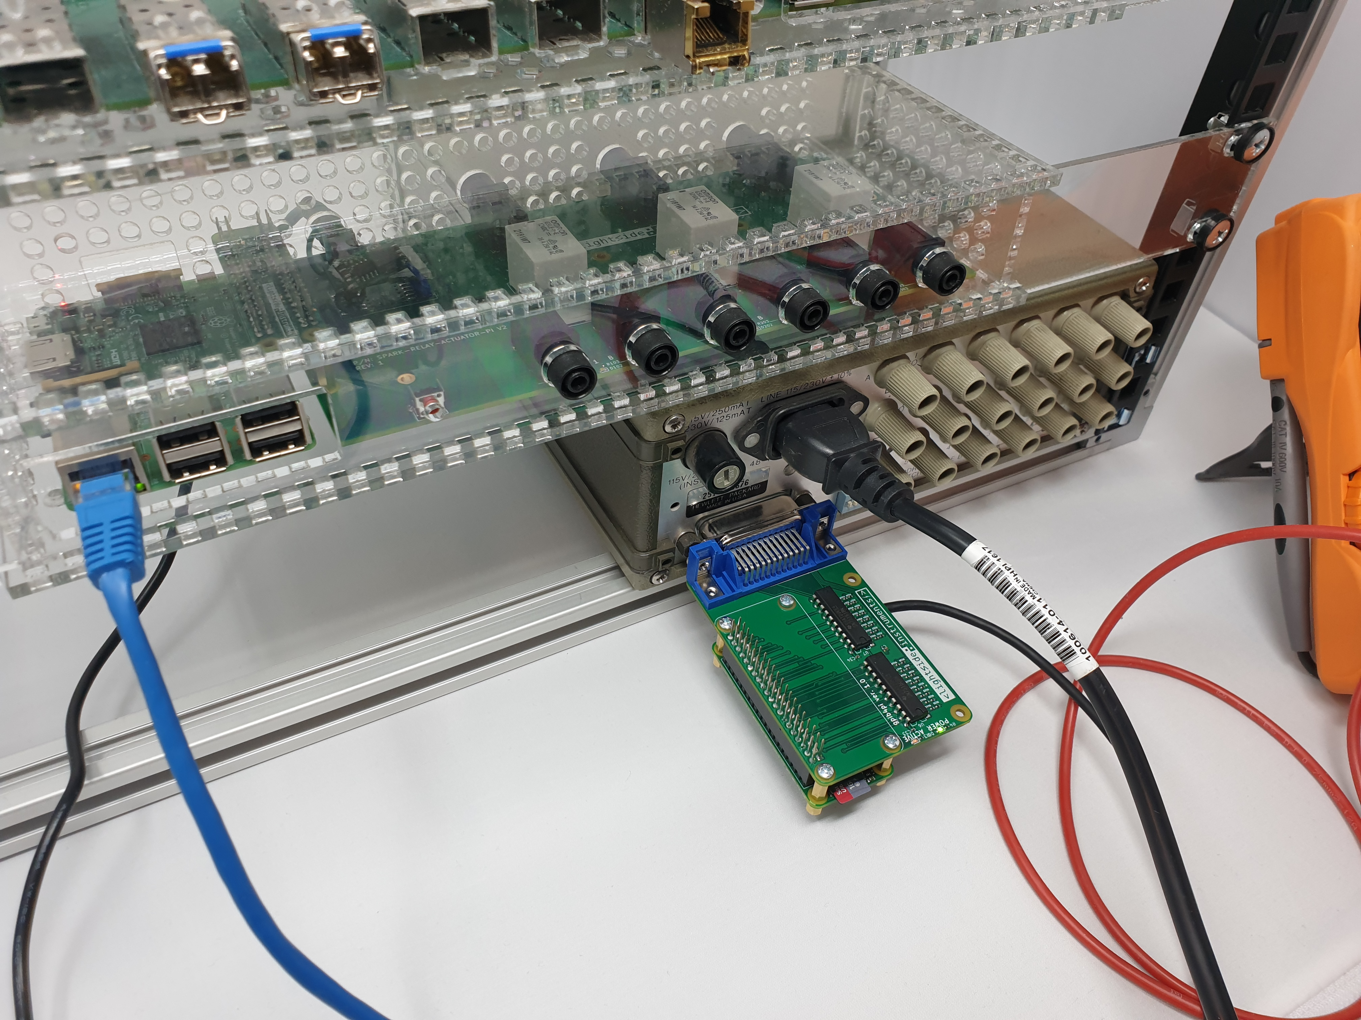
What got done
* Work on the rfc2544.py script RFC2544 sec. 26.6 – Reset (Python).
* Work on YANG/NETCONF managed 59306A relay actuator.
<number>

Slide 6
Remaining work
* Multi-stream implementation

